Slide 1

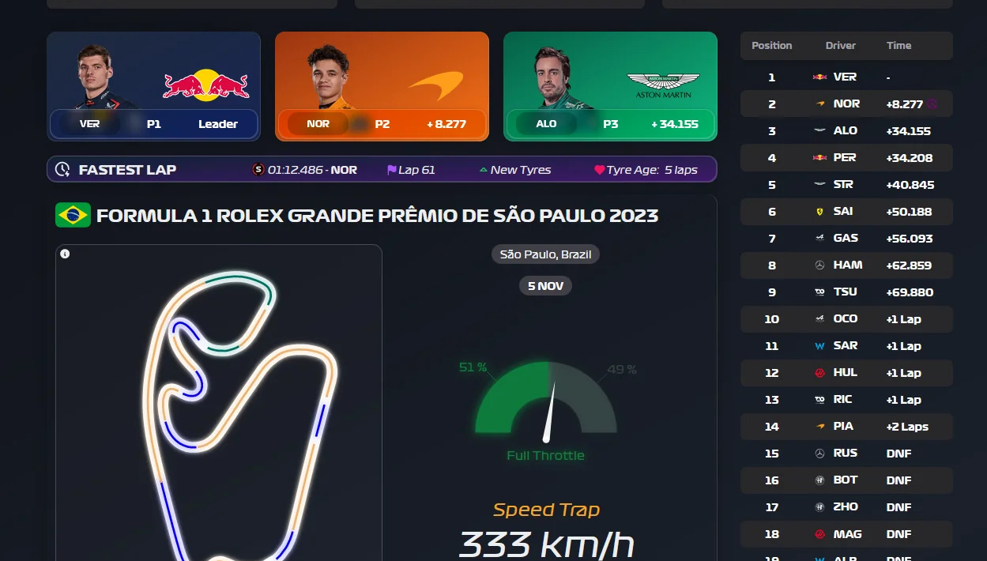


End to End F1 Analytics Dashboard

Slide 2
Team
Naveen Saragadam
Rohith Gadichanda
Likith Ramesh

Slide 3
Outline
Introduction and Overview
Problem Statement
Project Solution Approach & Architecture
Key Features of Dashboard
Technologies and Tools
Next Steps

Slide 4
Introduction and Overview
Formula 1 (F1) is the world’s premier single-seater racing championship, featuring 20 drivers from 10 teams competing in high-performance, open-wheel cars across a global calendar of Grand Prix Races.
Objective:
To create a interactive analytics dashboard for formula 1, leveraging data from races, driver performances, and more
Data Source:
Ergast API (Depreciated Early 2025), Jolpica API

Slide 5
Problem statement
Formula 1 data is fragmented, making it difficult to access and analyze race statistics, compare driver/team performance, and gain insights from historical data. There is a need for a centralized, interactive dashboard that aggregates F1 data, offers visual analytics, and provides insights for performance analysis.

Slide 6
Project Solution Approach
Build an Automated ETL pipeline On ADF
Implementing Medallion Architecture
Create a central Data warehousing solution(Synapse Analytics) for running analytics
Use PowerBI for Dashboard

Slide 7
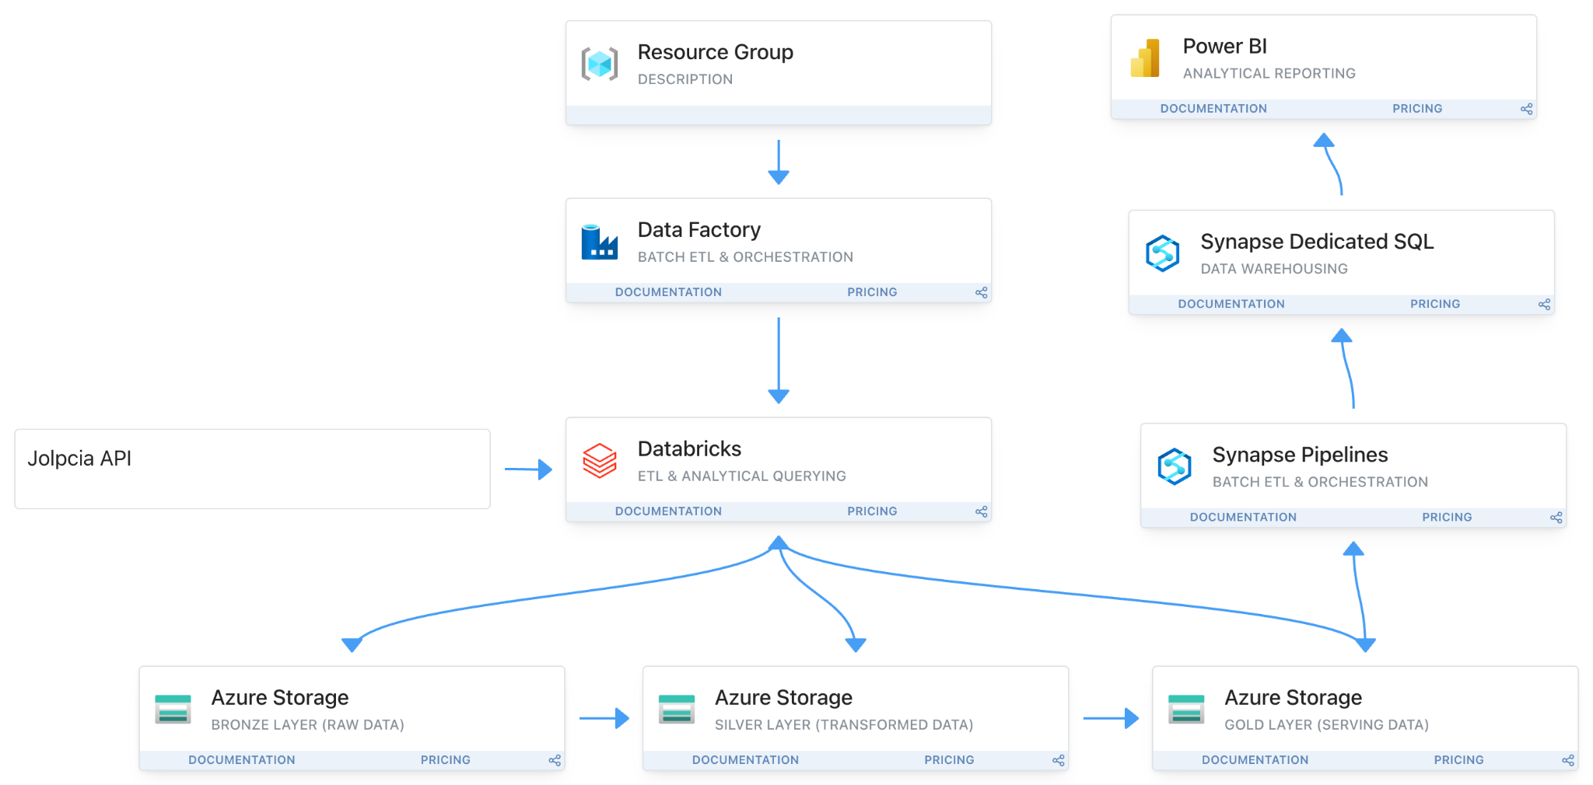
Azure Architecture

Slide 8
Technologies and tools
Azure Cloud (Data Factory, Synapse Analytics, ADLS gen 2, etc)
Databricks (For Data Transformations)
PowerBI (For Dashboard Development)
Jolpica API (For Source Data)
Jira (Project Management)

Slide 9
Key Features of Dashboard
jfadfa1
Race Statistics
Driver Comparisons
Team Comparisons
Historical Comparisons
Season Comparisons
Live comparison(Possibility with streaming data solution)

Slide 10
Current Progress
Investigating Project Timelines
Investigating Jolpica API
Implementing Smaller Azure projects to get familiar with Azure Pipelines
Identified Key objectives as ETL pipeline and Analytics Dashboard enabling Parallel development

Slide 11
Solution Proposal For Parallel Development
Provision All necessary Azure Services and Enable Data Connections (ex: ADLS to DataBricks)
Backfill Data for a single Season as Source Data for Dashboard Development
Work on ETL pipeline to handle Incremental Data load for History
Investigate Performance Optimisations (Implementing SCD 2, Partition Strategy etc)
Use Iterative Approach for Development via Jira

Slide 12
What next?
Investigate Tentative Timelines
Ingest a season’s worth of data into medallion architecture
Create a Dimensional Model for warehousing (Fact and Dimension tables)
Assign tasks on Jira for tracking progress of the project
Assign Responsibilities among teammates

Slide 13
Timeline
Sample Pipelines
Backfill One season Data
Analytics and Dashboard Dev
ETL pipeline Dev
Prototype Dashboard
User testing
Dev hand-off

Slide 14
Questions?

Slide 15
References
DE Pipeline: https://github.com/salineroa/formula-1-racing-data-pipeline?tab=readme-ov-file
Analytics Dashboard: https://github.com/lucia-corsan/Formula-One-ML/tree/main

